Slide 1
RNA-seq with R-bioconductor Part 1
Maarten Leerkes PhD

Slide 2
Topics
What is R
What is Bioconductor
What is RNAseq

Slide 3
What is R
R is a programming language and software environment for statistical computing and graphics. The R language is widely used among statisticians and data miners for developing statistical software[2][3] and data analysis.

Slide 4
What is R
R is an implementation of the S programming language combined with lexical scoping semantics inspired by Scheme. S was created by John Chambers while at Bell Labs. There are some important differences, but much of the code written for S runs unaltered.

Slide 5
What is R
R is a GNU project. The source code for the R software environment is written primarily in C, Fortran, and R. R is freely available under the GNU General Public License, and pre-compiled binary versions are provided for various operating systems. R uses a command line interface; there are also several graphical front-ends for it.

Slide 6
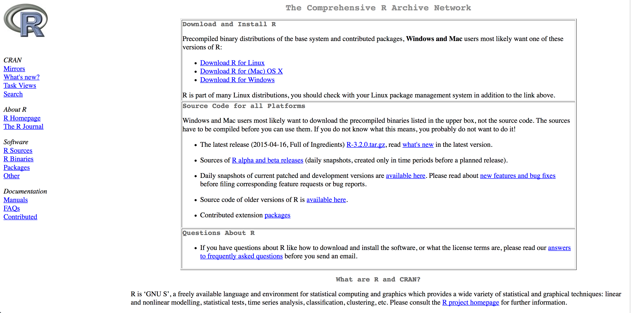
DOWNLOAD R FROM CRAN: http://cran.r-project.org/

Slide 7


Slide 8
Topics
What is R
What is Bioconductor
What is RNAseq

Slide 9

Rstudio
https://www.rstudio.com/products/rstudio/download/

Slide 10
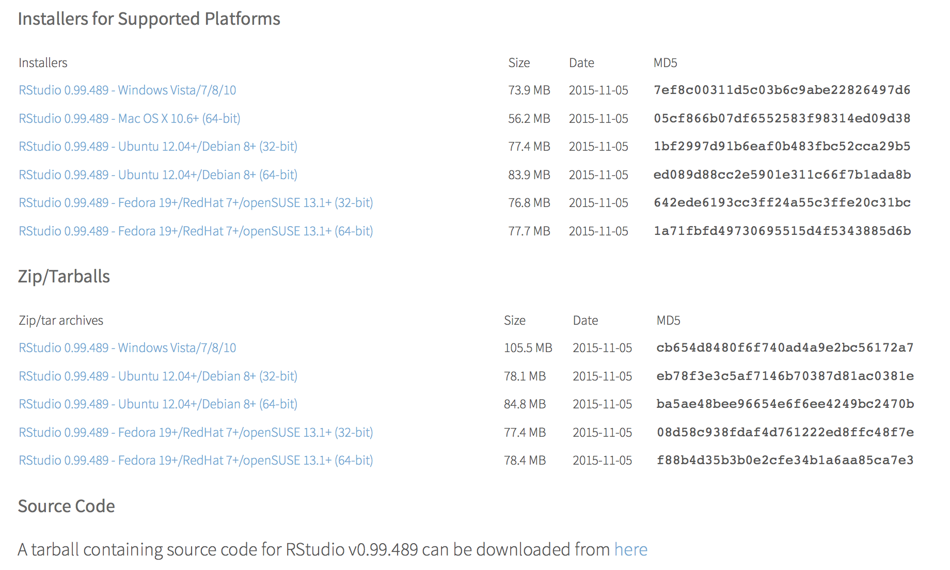
Rstudio https://www.rstudio.com/products/rstudio/download/

Slide 11

What is Bioconductor

Slide 12
Topics
What is R
What is Bioconductor
What is RNAseq

Slide 13
What is RNAseq
RNA-seq (RNA Sequencing), also called Whole Transcriptome Shotgun Sequencing (WTSS), is a technology that uses the capabilities of next-generation sequencing to reveal a snapshot of RNA presence and quantity from a genome at a given moment in time.

Slide 14
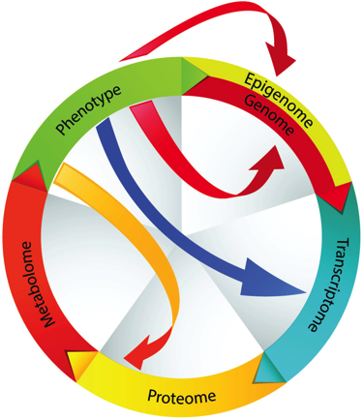
What is RNAseq Whole Transcriptome Shotgun Sequencing hints to phenotypes

Slide 15
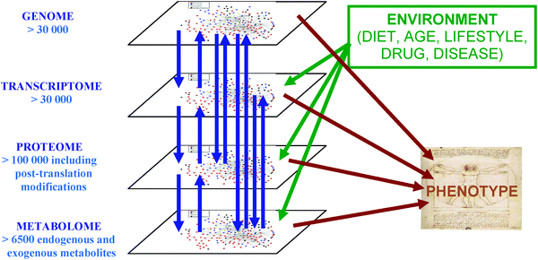
What is RNAseq
Whole Transcriptome Shotgun Sequencing hints to phenotypes

Slide 16
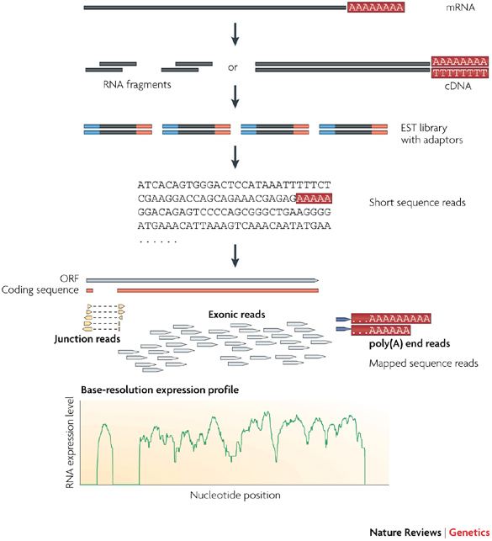
Notes:
http://thegenomefactory.blogspot.com/2013/08/paired-end-read-confusion-library.html
https://www.biostars.org/p/106291/
https://www.biostars.org/p/95803/
https://www.biostars.org/p/109221/

Slide 17
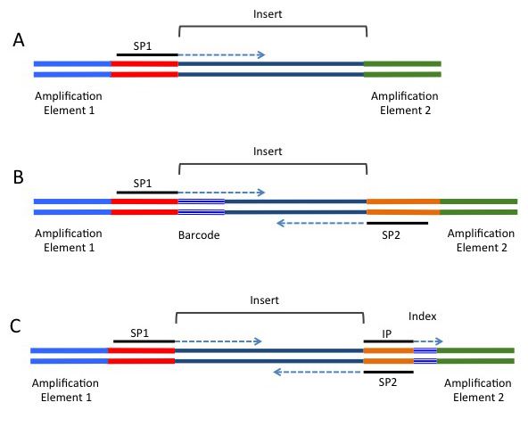
Insert size
Notes:
http://rnaseq.uoregon.edu/
Schematic showing the locations of various functional elements that can be included in adapters. The elements shown here are specific to the Illumina platform. The sequencing primers are referred to as SP1 (primary sequencing primer) and SP2 (paired-end primer). IP refers to the sequencing primer for the index read. (A) Minimal adapter components. (B) "In-line" barcode configuration supporting a paired-end read. (C) Index configuration supporting a paired-end read.
http://www.mbl.edu/jbpc/files/2014/05/Bioanalyzer_for_NGS_slideshow.pdf

Slide 18
Sequencing by synthesis
Intro to Sequencing by Synthesis:
https://www.youtube.com/watch?v=HMyCqWhwB8E
http://rnaseq.uoregon.edu/
https://www.youtube.com/watch?v=womKfikWlxM

Slide 19
Topics
What is R
What is Bioconductor
What is RNAseq
Comes together in: RNA-seq with R-bioconductor

Slide 20
Different Kinds of Objects in R
Objects.
The following data objects exist in R:
vectors
lists
arrays
matrices
tables
data frames
Some of these are more important than others. And there are more.

Slide 21
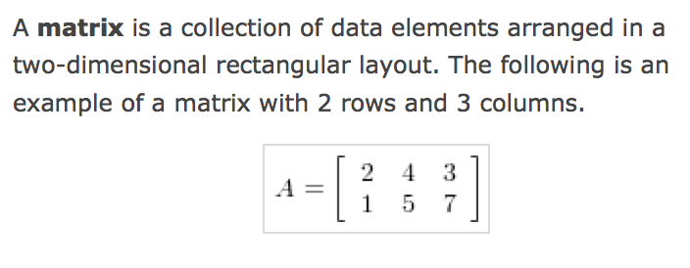

Slide 22
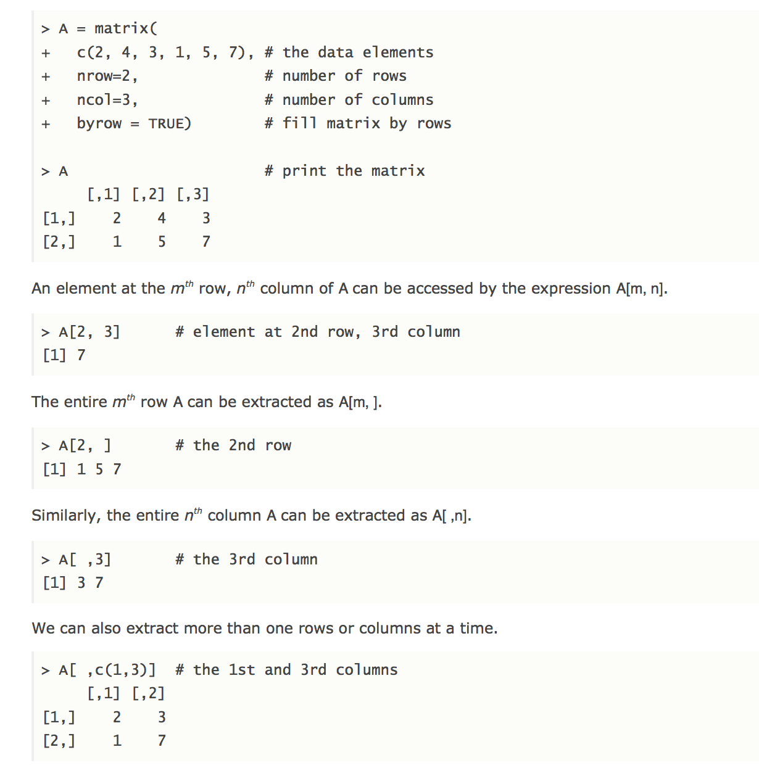

Slide 23
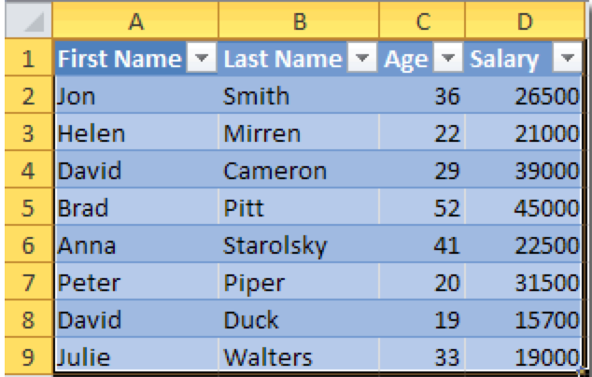
A data frame is used for storing data tables. It is a list of vectors of equal length.
A data frame is a table, or two-dimensional array-like structure, in which each column contains measurements on one variable, and each row contains one case. As we shall see, a "case" is not necessarily the same as an experimental subject or unit, although they are often the same.

Slide 24
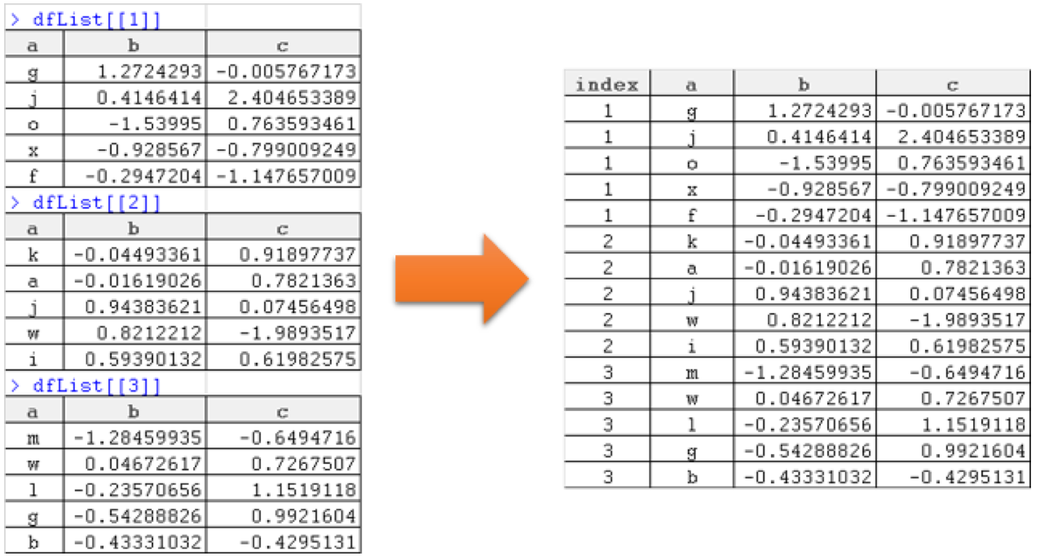
Combine list of data frames into single data frame, add column with list index: list of vectors of equal length.

Slide 25
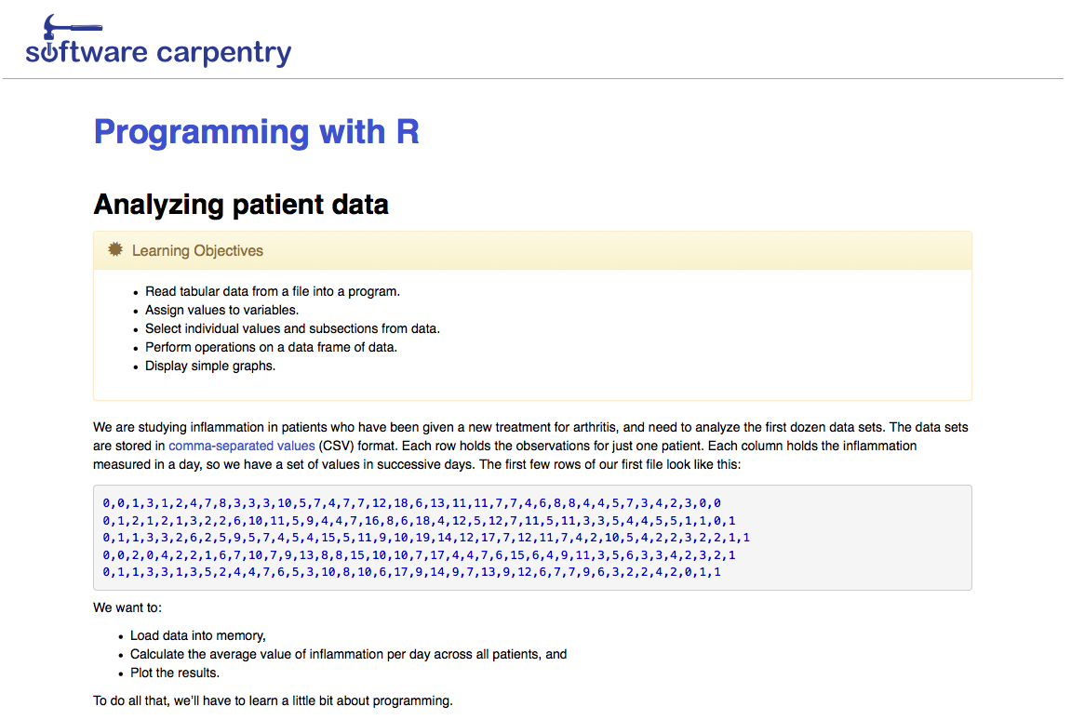
Methods: Software Carpentry: http://swcarpentry.github.io/r-novice-inflammation/01-starting-with-data.html

Slide 26
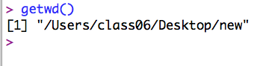
Current Working Directory cwd

Slide 27
Topics
What is R
What is Bioconductor
What is RNAseq

Slide 29
Sequencing by synthesis
Intro to Sequencing by Synthesis:
https://www.youtube.com/watch?v=HMyCqWhwB8E

Slide 30
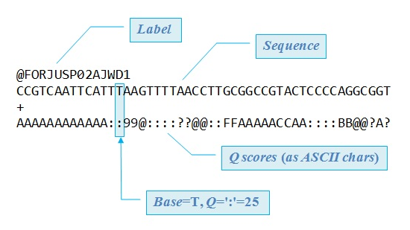
FASTQ read with 50nt in Illumina format (ASCII_BASE=33). There are always four lines per read.
Notes:
FASTQ read with 50nt in Illumina format (ASCII_BASE=33). There are always four lines per read. The first line starts with '@', followed by the label. The third line starts with '+'. In some variants, the '+' line contains a second copy of the label. The fourth line contains the Q scores represented as ASCII characters.

Slide 31
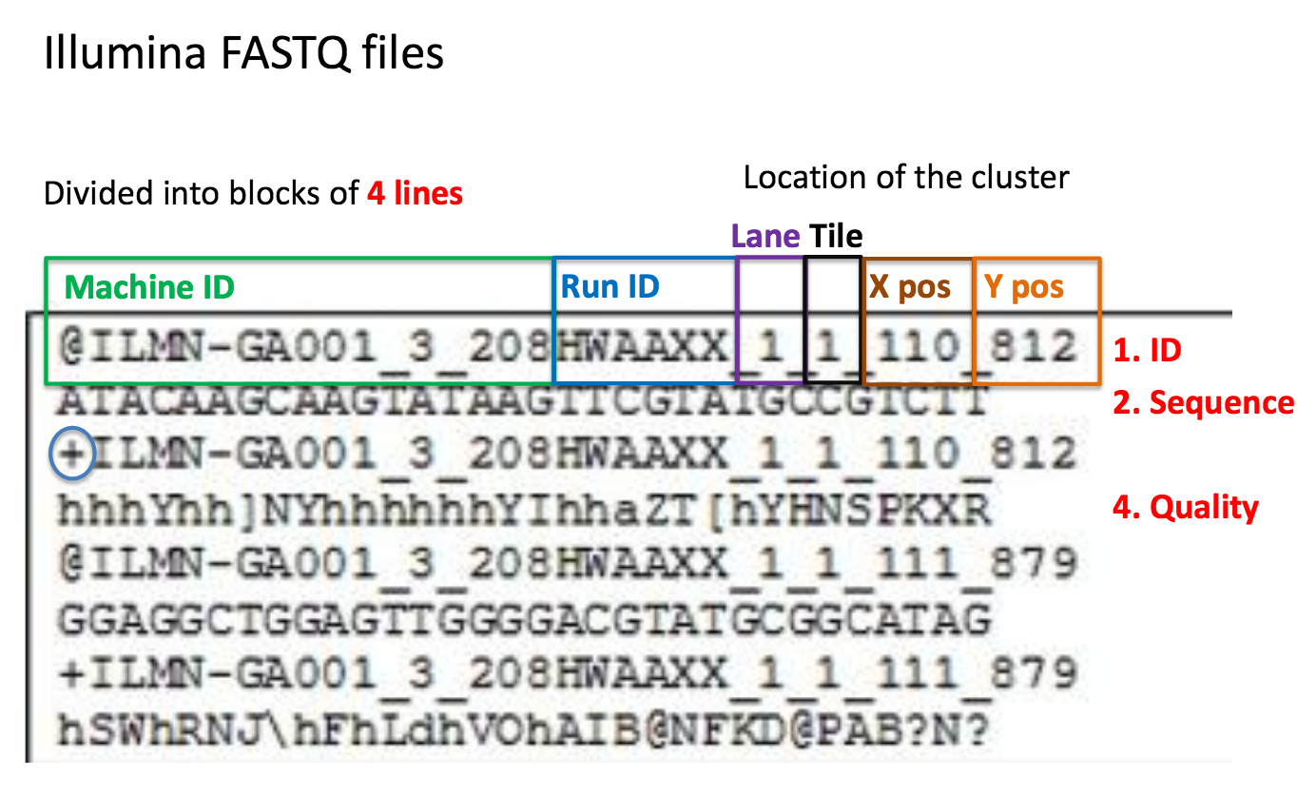
Information in ID line
Notes:
http://data.bits.vib.be/pub/trainingen/NGSIntro/NGSbasics.pdf

Slide 32
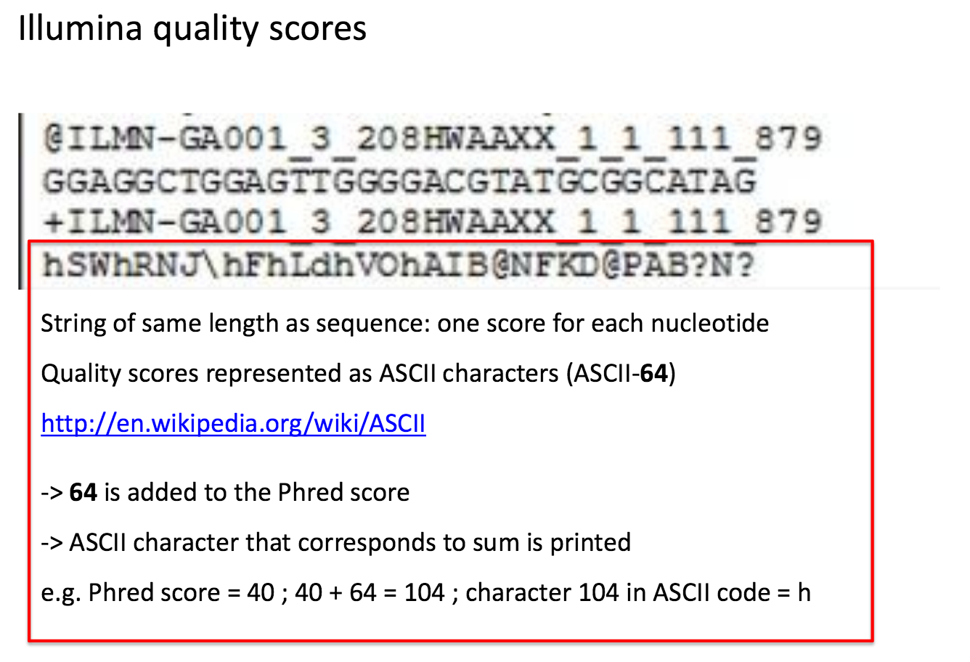
Information in Quality Line
Notes:
http://data.bits.vib.be/pub/trainingen/NGSIntro/NGSbasics.pdf

Slide 33
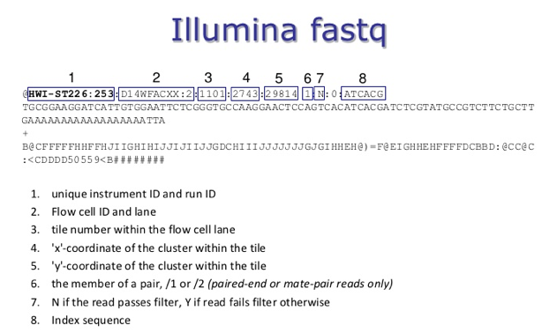

Slide 34
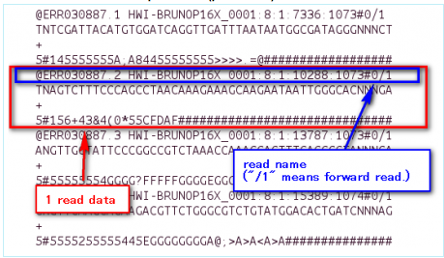
Paired end: read 1 in one fastq file
Notes:
http://cell-innovation.nig.ac.jp/wiki2/tiki-index.php?page=DST0000075
http://cell-innovation.nig.ac.jp/wiki2/tiki-index.php?page=DST0000075

Slide 35
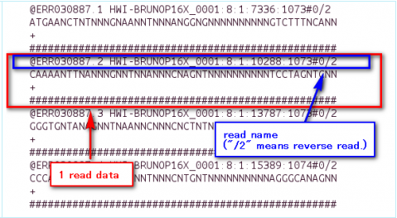
Paired end: read 2 in another fastq file
Notes:
http://cell-innovation.nig.ac.jp/wiki2/tiki-index.php?page=DST0000075

Slide 36
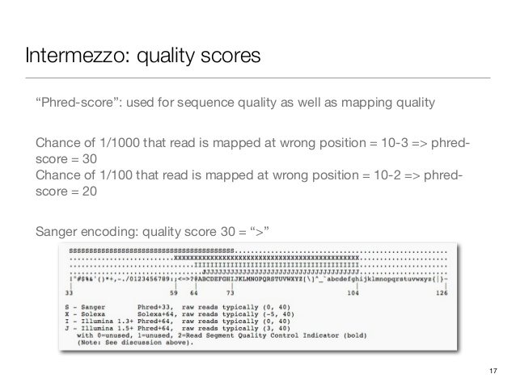
Notes:
http://www.slideshare.net/jandot/nextgeneration-sequencing-variation-discovery
http://gatkforums.broadinstitute.org/discussion/4260/how-should-i-interpret-phred-scaled-quality-scores
http://maq.sourceforge.net/qual.shtml
https://www.biostars.org/p/15953/
http://drive5.com/usearch/manual/quality_score.html

Slide 37
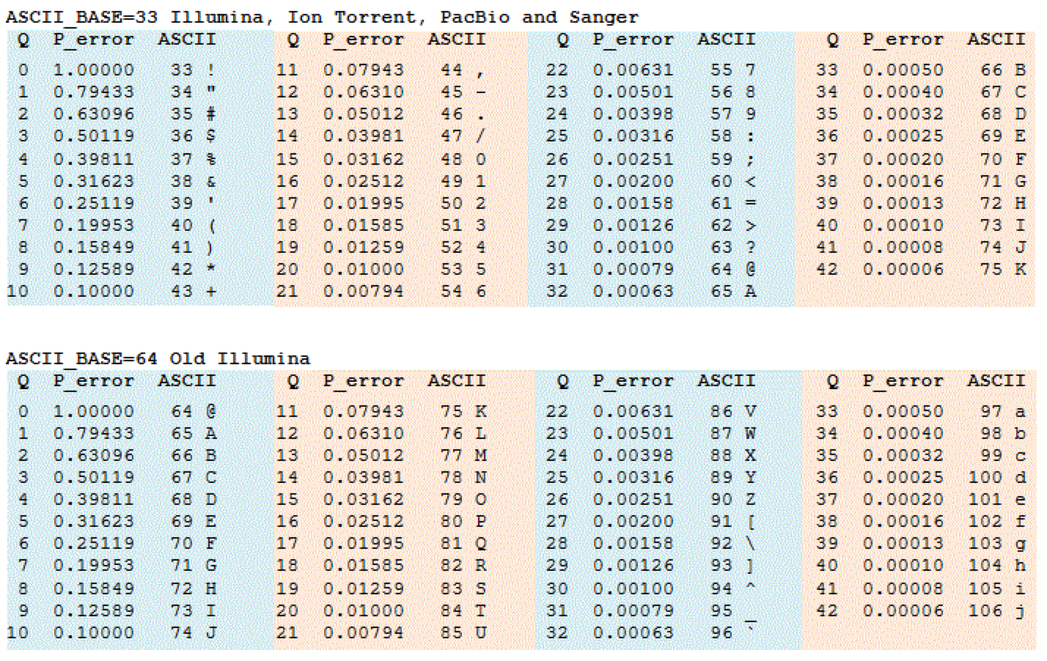
Ascii off-sets

Slide 38
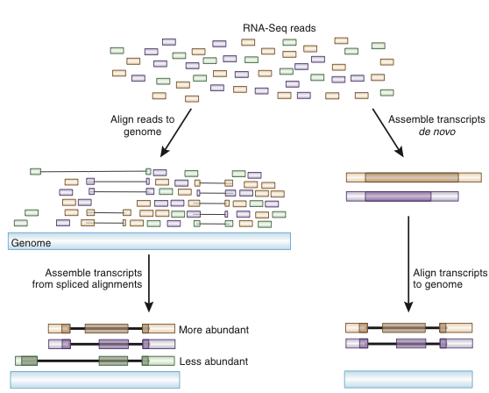
Numerous Possible Analysis Strategies
There is no one ‘correct’ way to analyze RNA-seq data
Two major branches
Direct alignment of reads (spliced or unspliced) to genome or transcriptome
Assembly of reads followed by alignment*
FASTQ
or transcriptome
SAM/BAM
Image from Haas & Zody, 2010
*Assembly is the only option when working with a creature with no genome sequence,
alignment of contigs may be to ESTs, cDNAs etc

Slide 39
What is an Annotation File in GFF (General Feature Format) ?
The evolution was something like this:
GFF 2 -> GTF -> GFF 3
conversions: http://song.cvs.sourceforge.net/song/software/scripts/gtf2gff3/
GFF/GTF File Format - Definition and supported options
The GFF (General Feature Format) format consists of one line per feature, each containing 9 columns of data, plus optional track definition lines. The following documentation is based on the Version 2 specifications:
http://useast.ensembl.org/info/website/upload/gff.html?redirect=no
Notes:
http://useast.ensembl.org/info/website/upload/gff.html?redirect=no

Slide 40
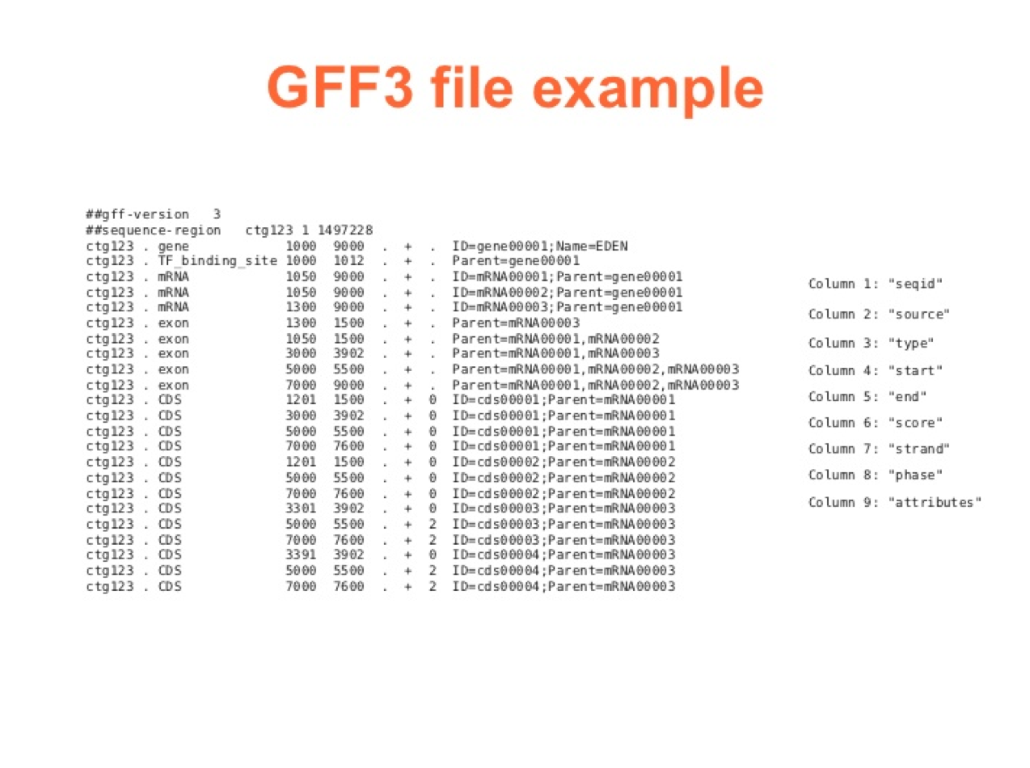

Slide 41
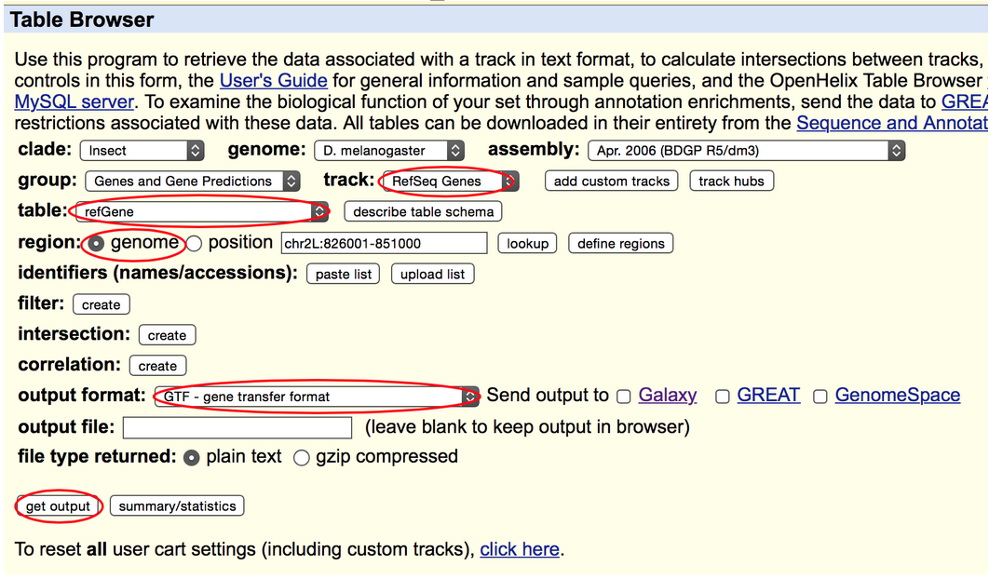
UCSC Genome Browser

Slide 42
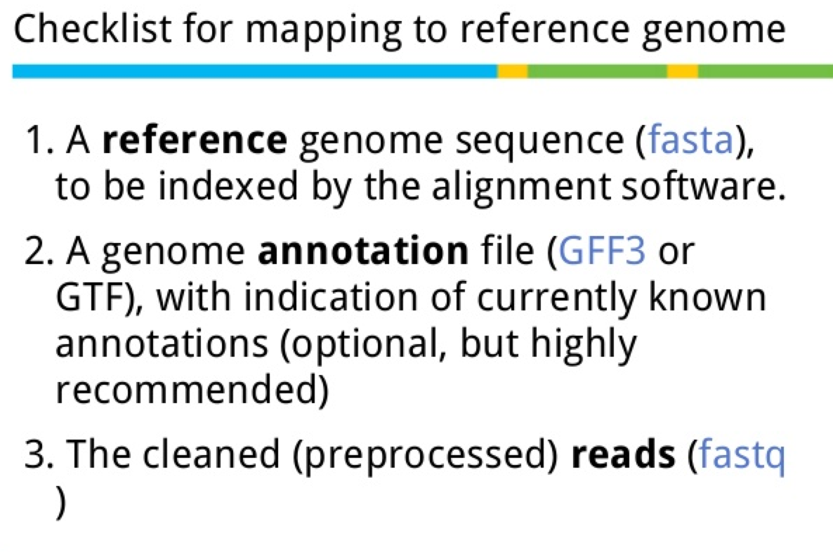

Slide 43
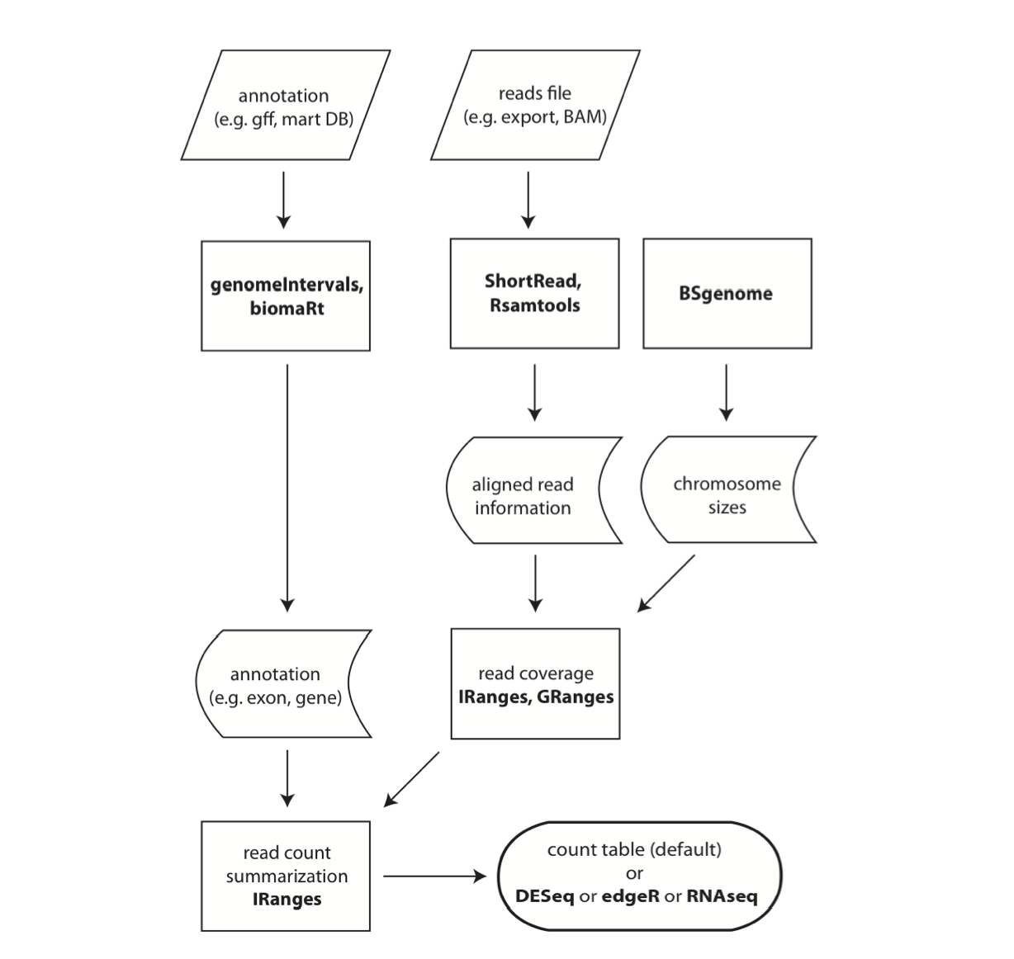
Notes:
RNA-Seq Procedure Overview. The R packages used for the different steps are emphasized in bold face.

Slide 44
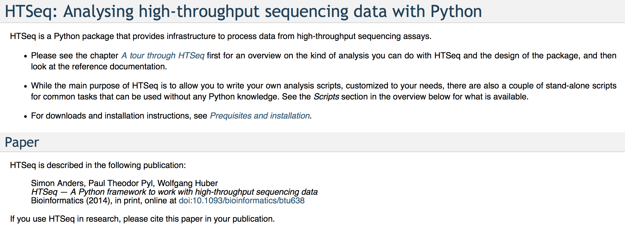
Alternative to count tables: HTSeq

Slide 45
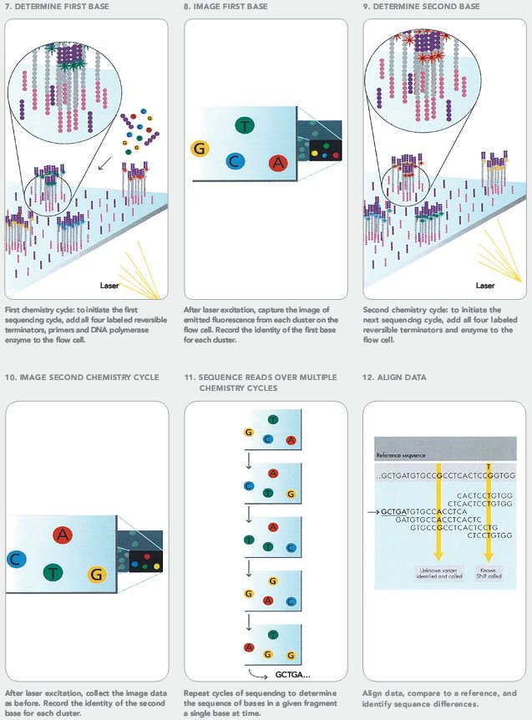
Illumina Clonal Expansion Followed By Image Processing
Notes:
Both the Illumina and SOLiDTM chemistry differ from 454TM in that they incorporate florescent dyes as markers of nucleotide extension. Illumina employ a novel approach to clonal expansion termed bridge amplification. This is performed on the surface of the flow cell (see figure 3).

Slide 46
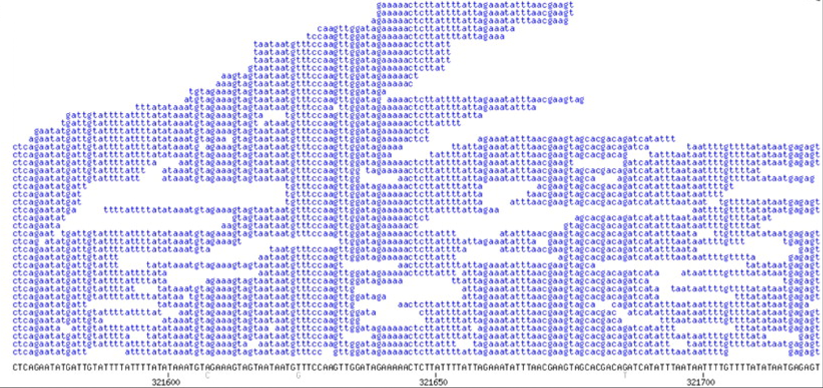
Pile up sequences to reference genome

Slide 47
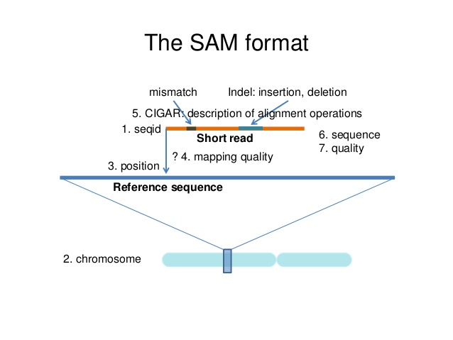

Slide 48
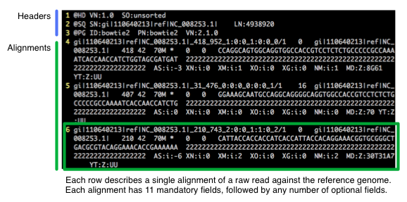
SAM format: What are sam/bam files http://biobits.org/samtools_primer.html

Slide 49
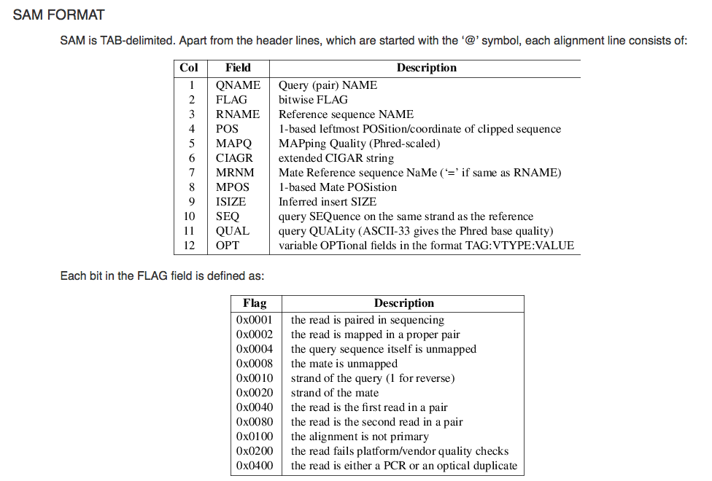

Slide 50
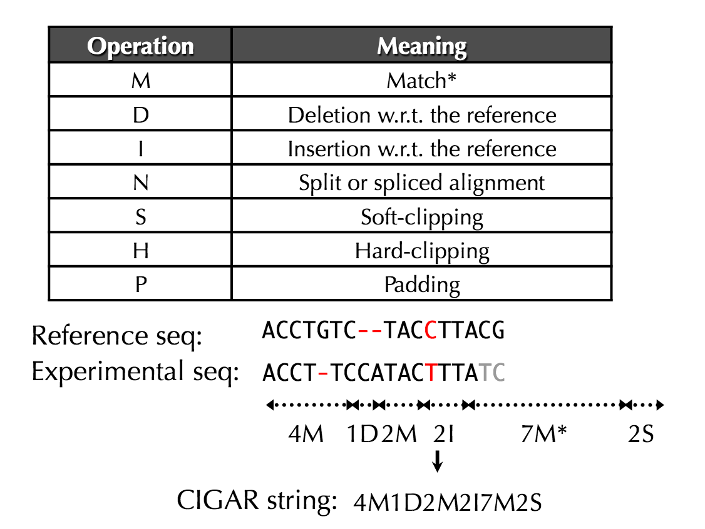
Meaning of Fields: CIGAR Score
Notes:
http://fasta.bioch.virginia.edu/cshl/pdf/14/ajm/ecg2014_2_variation.pdf

Slide 51
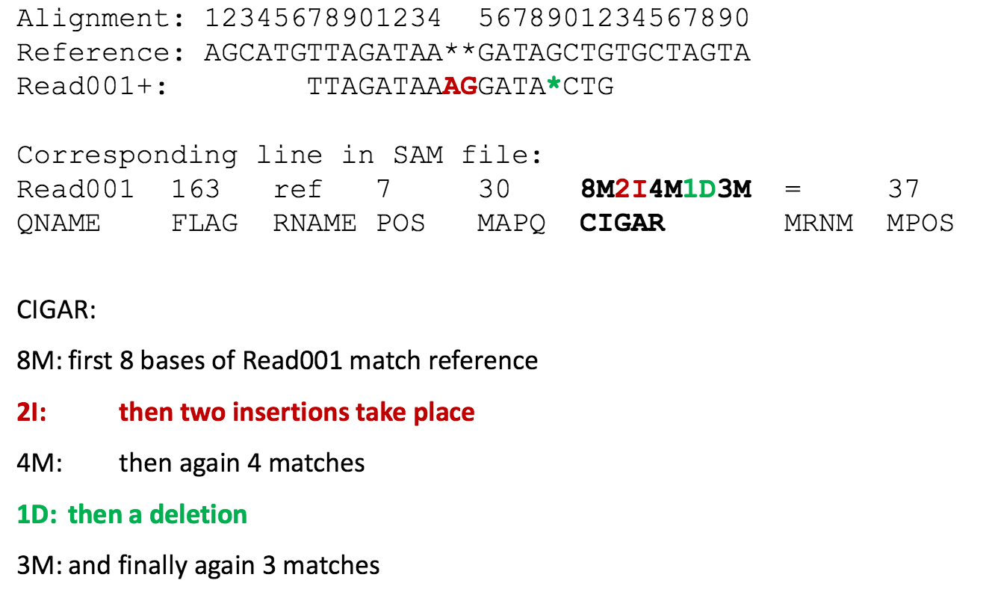
Read CIGAR score

Slide 52
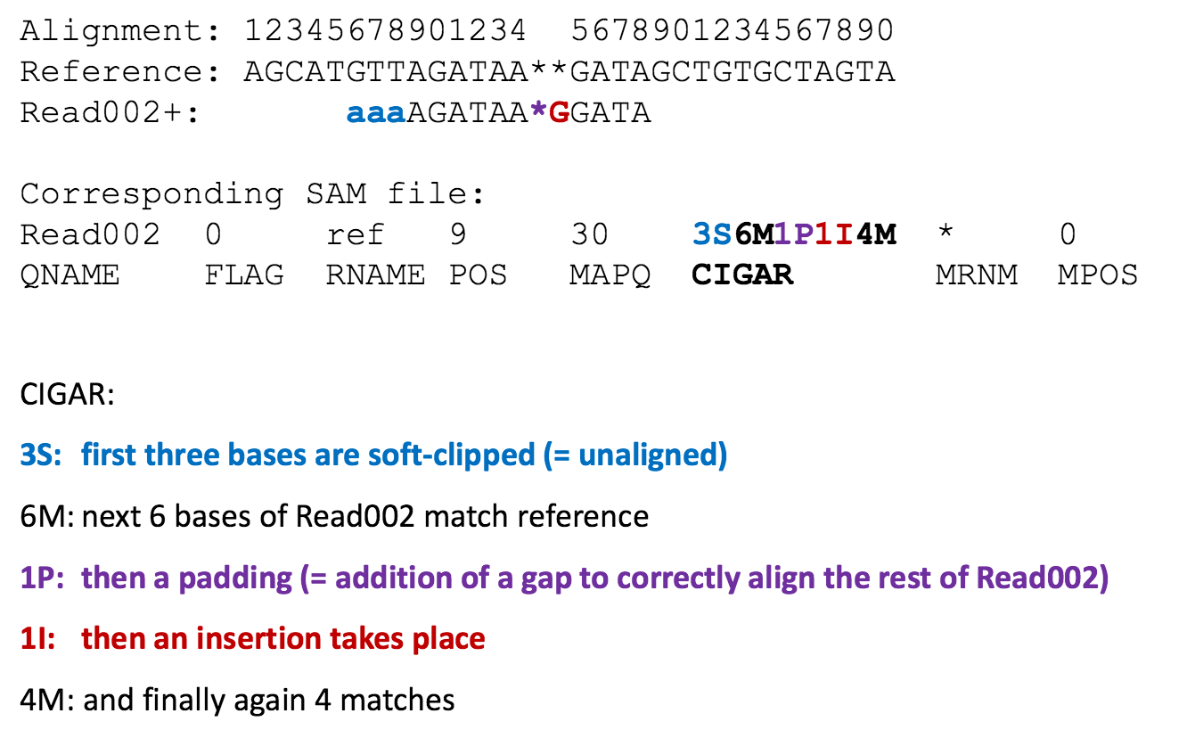
Read CIGAR score: A soft-clipped sequence is an unmatched fragment in a partially mapped read.
Notes:
http://data.bits.vib.be/pub/trainingen/NGSIntro/NGSbasics.pdf
http://www.biomedcentral.com/1471-2105/12/S14/S7

Slide 53
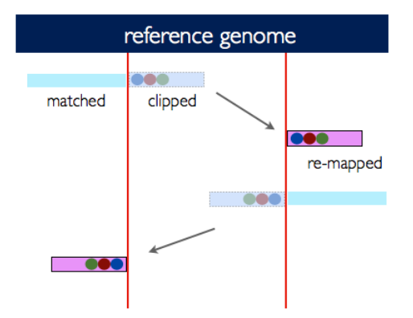
Gapped alignment calls

Slide 54
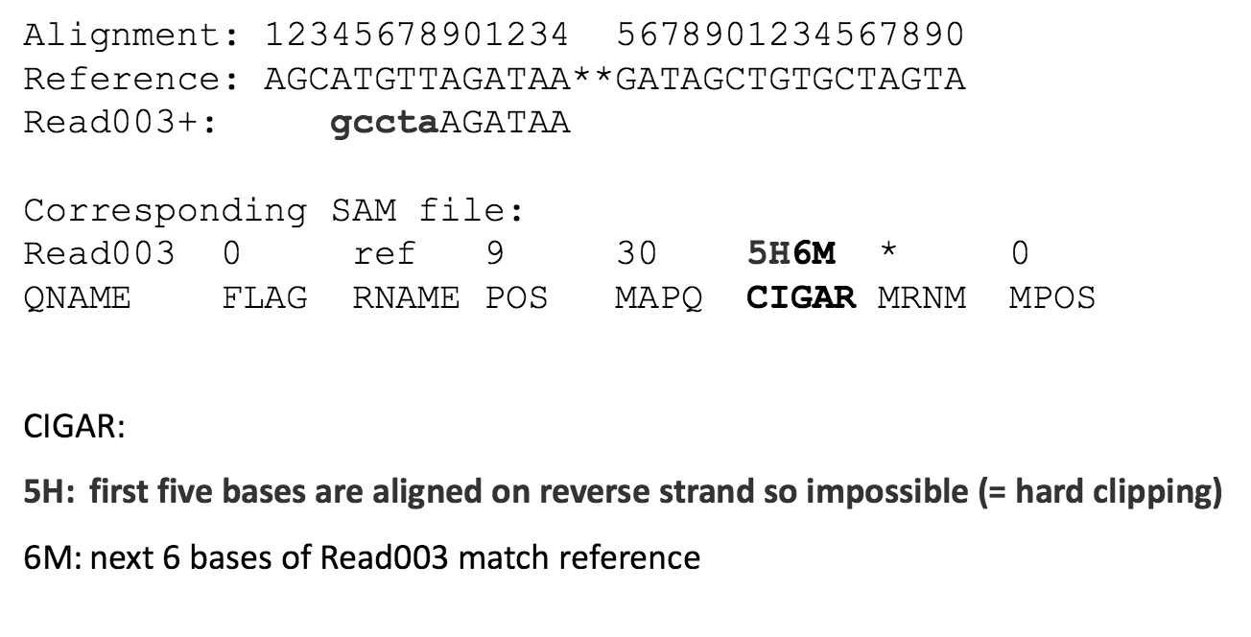
Read CIGAR score
Notes:
http://data.bits.vib.be/pub/trainingen/NGSIntro/NGSbasics.pdf
https://www.biostars.org/p/109333/
https://www.biostars.org/p/119537/
https://www.biostars.org/p/18733/
https://www.biostars.org/p/95113/

Slide 55
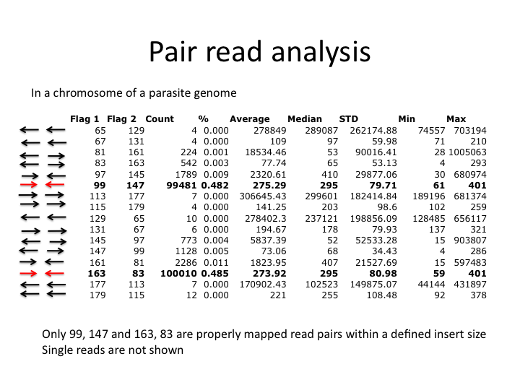

Slide 56
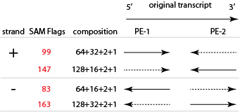
Binary numbers: flags to orientation

Slide 57
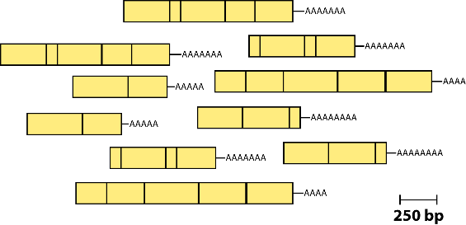
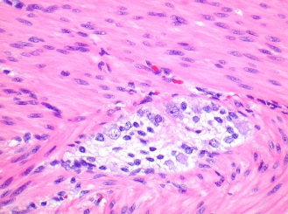
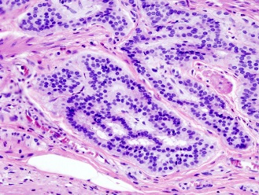
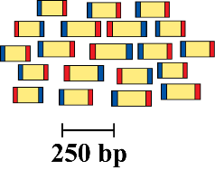
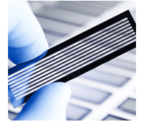
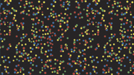
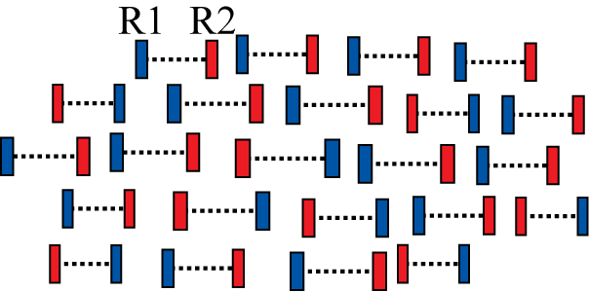
RNA sequencing: abundance comparisons between two or more conditions / phenotypes
Samples of interest
Generate cDNA, fragment, size select, add linkers
Condition 1
(normal tissue)
Condition 2
(diseased tissue)
Isolate RNAs
Sequence ends
Map to genome, transcriptome, and predicted exon junctions
100s of millions of paired reads
10s of billions bases of sequence
Downstream analysis

Slide 58
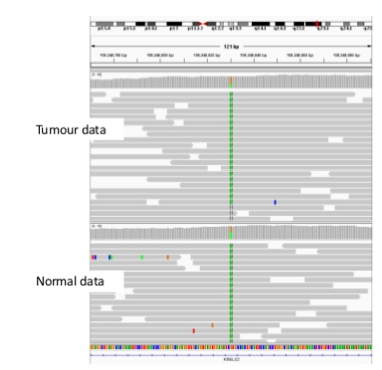
Compare two samples for abundance differences
Notes:
http://www.bios.unc.edu/~weisun/software/asSeq.pdf

Slide 59
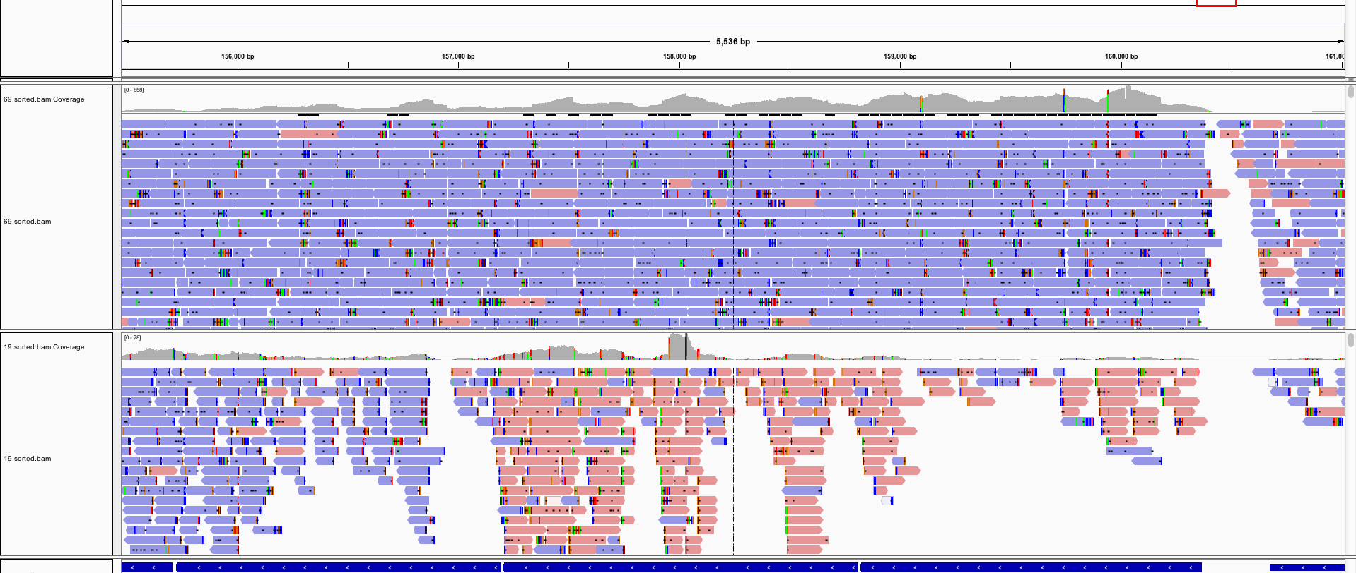
Transcript abundances differ in pile-up

Slide 60
Genes Have ‘Structure’, Solve By Mapping
This leads to for example analysis of intron-exon structure

Slide 61
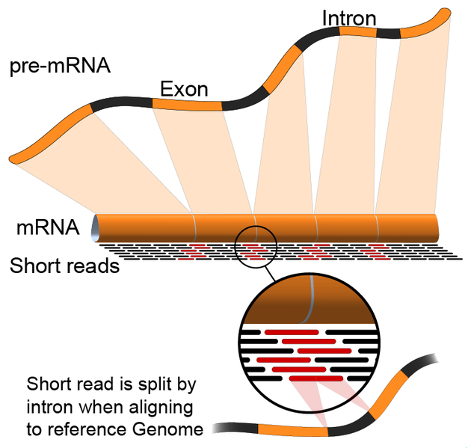
Genes And Transcripts

Slide 62
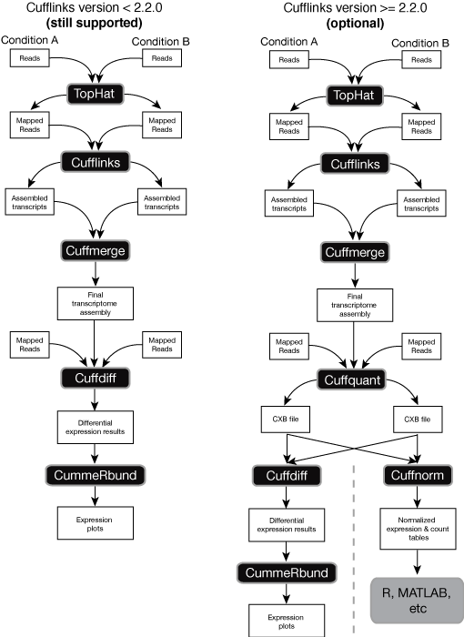
Current Paradigm: “cuff-suit”

Slide 63
Common analysis goals of RNA-Seq analysis (what can you ask of the data?)
Gene expression and differential expression
Alternative expression analysis
Transcript discovery and annotation
Allele specific expression
Relating to SNPs or mutations
Mutation discovery
Fusion detection
RNA editing

Slide 64
Back to the Demo
Introduction to RNA sequencing
Rationale for RNA sequencing (versus DNA sequencing)
Hands on tutorial

Slide 66
Deseq and DEseq2
Method based on the negative binomial distribution, with variance and mean linked by local regression
DEseq2:
No demo scripts available yet:
http://www.bioconductor.org/packages/release/bioc/vignettes/DESeq2/inst/doc/DESeq2.pdf

Slide 67
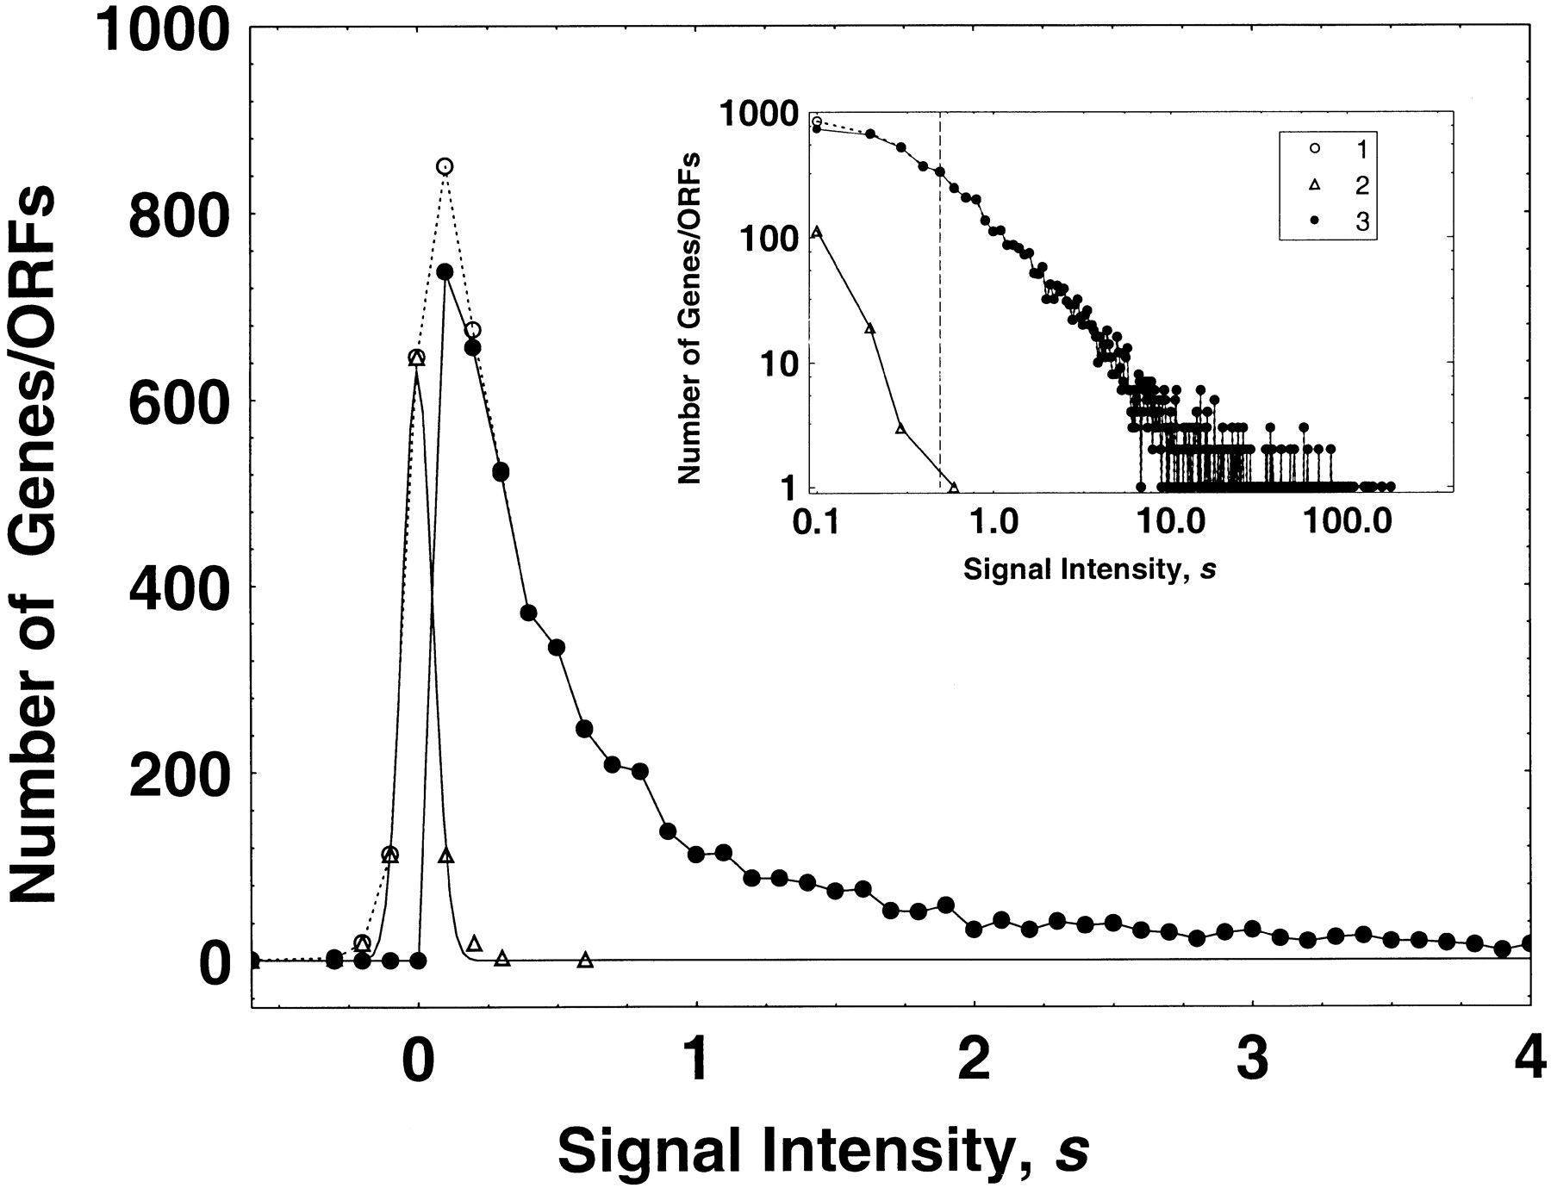

The empirical frequency distribution of the hybridization signal intensity values for Affymetrix microarray hybridization data for normal yeast cell genes/ORFs (Jelinsky and Samson 1999).
Kuznetsov V A et al. Genetics 2002;161:1321-1332
Copyright © 2002 by the Genetics Society of America
Notes:
The empirical frequency distribution of the hybridization signal intensity values for Affymetrix microarray hybridization data for normal yeast cell genes/ORFs (Jelinsky and Samson 1999). We checked that the background noise intensity signals (▵) were distributed with an approximately normal distribution function with mean zero and standard deviation 0.054. Intensity signal distribution before (○) and after (●) subtraction of the background noise from the signal values is shown. The total hybridization signal intensity has been normalized (by Jelinsky and Samson 1999) with respect to the mean number of mRNA molecules per yeast cell. A point (s, f(s)) on the major plot shows the number of genes/ORFs, f, which have the signal intensity value, s. The vertical discontinuous line indicates the lower bound of the “reliably” detectable intensity signal values (the lower bound corresponds to 0.5 transcripts per cell). The window plot (log-log plot) shows the signal intensity distributions before and after subtraction of noise, shown over the full range of the positive signal intensity values.

Slide 68

Empirical relative frequency distributions of the gene expression levels.
Kuznetsov V A et al. Genetics 2002;161:1321-1332
Copyright © 2002 by the Genetics Society of America
Notes:
Empirical relative frequency distributions of the gene expression levels. Log-log plots are shown. (a) ●, log-phase yeast cell growth library with 20,096 SAGE tags; solid step-function line, GDP model with k = 0.974 ± 0.004, b = −0.173 ± 0.004; dotted line, simple power law with k = 1.03 ± 0.005. Inset plot: ●, empirical cumulative fraction function R_{e} values [ ]for the ● histogram (main plot); the solid line is the corresponding theoretical model computed by the GDP model (main plot). (Cumulative data reduce the apparent “noise” in the histogram data.) (b) ○, mouse mammary cells cDNA library 341 of size 36,675 ESTs; solid step-function line, GDP model with k = 1.44 ± 0.006, b = 1.34 ± 0.002. (c) ●, human colon cancer cells SAGE library 2892.2 of size 22,637 tags; solid step-function line, GDP model for ● data at k = 1.08 ± 0.030, b = −0.28 ± 0.010; □, mouse brain (primary meduloblastoma) cells SAGE library 3871 of size 43,274 tags. (d) ○, human choriocarcinoma cells cDNA library 2427 of size 10,087 ESTs; solid step-function line, GDP model with k = 1.88 ± 0.044, b = 1.34 ± 0.005.

Slide 69


Slide 70


Slide 71

Empirical (black dots) and fitted (red lines) dispersion values plotted against the mean of the normalised counts.
Notes:
Empirical (black dots) and fitted (red lines) dispersion values plotted against the mean of the normalised counts.
The dispersion can be understood as the square of the coecient of biological variation. So, if a gene's expression typically differs from replicate to replicate sample by 20%, this gene's dispersion is 0.2^2 = 0.04

Slide 72

Plot of normalised mean versus log2 fold change for the contrast untreated versus treated.
Notes:
Plot of normalised mean versus log2 fold change for the contrast untreated versus treated.
3 Inference: Calling differential expression
3.1 Standard comparison between two experimental conditions

Slide 73

Histogram of p-values from the call to nbinomTest.
Notes:
Histogram of p-values from the call to nbinomTest.

Slide 74
MvA plot for the contrast“treated”vs.“untreated” using two treated and only one untreated sample.
Notes:
MvA plot for the contrast“treated”vs.“untreated”, using two treated and only one untreated sample.

Slide 75

Expression Data Of 30 Most Highly Expressed Genes
Notes:
Heatmaps showing the expression data of the 30 most highly expressed genes. Left, the variance stabilisation transformed data (vsdFull) are shown, right, the original count data (cdsFull). In the left panel, the sample clustering aligns with the experimental factor (treated / untreated). The clustering and the colour scale in the right plot is dominated by a small number of data points with large values.

Slide 76

Euclidean distances between the samples as calculated from the variance stabilizing transformation of the count data
Notes:
Heatmap showing the Euclidean distances between the samples as calculated from the variance stabilising transformation of the count data.

Slide 77

Biological Effects Of Condition And Libtype
Notes:
PCA plot. The 7 samples shown in the 2D plane spanned by their first two principal components. This type of plot is useful for visualizing the overall effect of experimental covariates and batch effects. For this data set, no batch effects besides the known effects of condition and libType are discernible.

Slide 78

Mean expression versus log2 fold change plot. Significant hits (at padj<0.1) are coloured in red
Notes:
MA plot. Mean expression versus log2 fold change plot. Significant hits (at padj<0.1) are coloured in red.

Slide 79

Per-gene Dispersion Estimates and Fitted Mean- Dispersion Function
Per-gene Dispersion Estimates (shown by points) and Fitted Mean- Dispersion Function (red line).
Notes:
Fit Diagnostics. Per-gene dispersion estimates (shown by points) and the fitted mean- dispersion function (red line).

Slide 80
Differential Exon Usage
Detecting spliced isoform usage by exon-level expression analysis

Slide 81

Pasilla Data
The splicing factor pasilla (NOVA1 and NOVA2 ortholog) was knocked-down in Drosophila cell cultures

Slide 82

Types of Splicing
Notes:
Flattening of gene models: This (fictional) gene has three annotated transcripts involving three exons (light shading), one of which has alternative boundaries. We form counting bins (dark shaded boxes) from the exons as depicted; the exon of variable length gets split into two bins.

Slide 83

Expression Estimates From a Call to TestforDeu
Shown in red is the exon that showed significant differential exon usage.
Notes:
Fitted expression. The plot represents the expression estimates from a call to testForDEU. Shown in red is the exon that showed significant differential exon usage.

Slide 84

Normalized counts
As in previous Figure, with normalized count values of each exon in each of the samples.

Slide 85

Estimated Effects (After Subtraction Of Overall Changes In Gene Expression)
Notes:
Fitted splicing. The plot represents the estimated effects, as in Figure 3, but after subtraction of overall changes in gene expression.

Slide 86

Dependence of Dispersion on the Mean
Notes:
Dependence of dispersion on the mean. Each dot corre- sponds to one counting bin in the data of Brooks et al. (2010) (discussed in detail in the Results section); (x-axis) normalized count, averaged over all samples; (y-axis) estimate of the dispersion. The bars at the bottom denote dispersion values outside the plotting range (in particular, those cases in which the sample dispersion is close to zero). (Solid red line) The regression line; (dashed lines) the 1-, 5-, 95-, and 99-percentiles of the x2 distribution with 4 degrees of freedom scaled such that it has the fitted mean.

Slide 87

Notes:
The treatment of knocking down the splicing factor pasilla affects the fourth exon (counting bin E004) of the gene Ten-m (CG5723). (Top panel) Fitted values according to the linear model; (middle panel) normalized counts for each sample; (bottom panel) flattened gene model. (Red) Data for knockdown samples; (blue) control.

Slide 88

Distributions of Fold Changes of Exon Usage
Notes:
Fold changes of exon usage versus averaged normalized count value for all tested counting bins for the Brooks and coworkers data. (Red) Significance at 10% FDR. Bars at the margin represent bins with fold changes outside the plotting range.

Slide 89

Notes:
Ribosomal protein gene RpS14b (from the Brooks and coworkers data) is shown here as an example for a gene with heterogeneous dispersion. The first exon has zero count in the paired-end samples untreated 2, in the single-end sample treated 2, and in the paired-end sample treated 3, and large nonzero counts in the four other samples. Colors are as in Figure 3.

Slide 90
RNA Sequencing: Abundance Between Two Or More Conditions / Phenotypes
Isolate RNAs
Generate cDNA, fragment, size select, add linkers
Samples of interest
Condition 1
(normal tissue)
Condition 2
(diseased tissue)
Sequence ends
Map to genome, transcriptome, and predicted exon junctions
Downstream analysis
100s of millions of paired reads
10s of billions bases of sequence

Slide 91


Slide 92


Slide 93


Slide 94


Slide 95
Experimental Design: Best Softwares
http://arxiv.org/ftp/arxiv/papers/1505/1505.02017.pdf

Slide 96


Slide 97

Comparison of two designs for testing differential expression between treatments A and B. Treatment A is denoted by red tones and treatment B by blue tones.
Paul L. Auer, and R. W. Doerge Genetics 2010;185:405-416
Copyright © 2010 by the Genetics Society of America
Notes:
Comparison of two designs for testing differential expression between treatments A and B. Treatment A is denoted by red tones and treatment B by blue tones. In the ideal balanced block design (left), six samples \batchmode \documentclass[fleqn,10pt,legalpaper]{article} \usepackage{amssymb} \usepackage{amsfonts} \usepackage{amsmath} \pagestyle{empty} \begin{document} \((m{=}6)\) \end{document} are bar coded, pooled, and processed together. The pool is then divided into six equal portions that are input to six lanes \batchmode \documentclass[fleqn,10pt,legalpaper]{article} \usepackage{amssymb} \usepackage{amsfonts} \usepackage{amsmath} \pagestyle{empty} \begin{document} \((L{=}6)\) \end{document} of the flow cell. Bar coding in the balanced block design results in six technical replicates \batchmode \documentclass[fleqn,10pt,legalpaper]{article} \usepackage{amssymb} \usepackage{amsfonts} \usepackage{amsmath} \pagestyle{empty} \begin{document} \((T{=}6)\) \end{document} of each sample, while balancing batch and lane effects and blocking on lane. The balanced block design also allows partitioning of batch and lane effects from the within-group biological variability. The confounded design (right) represents a typical RNA-Seq experiment and consists of the same six samples, with no bar coding, and does not permit partitioning of batch and lane effects from the estimate of within-group biological variability.

Slide 98

A multiple flow-cell design based on three biological replicates within seven treatment groups.
Paul L. Auer, and R. W. Doerge Genetics 2010;185:405-416
Copyright © 2010 by the Genetics Society of America
Notes:
A multiple flow-cell design based on three biological replicates within seven treatment groups. There are three flow cells with eight lanes per flow cell. The control \batchmode \documentclass[fleqn,10pt,legalpaper]{article} \usepackage{amssymb} \usepackage{amsfonts} \usepackage{amsmath} \pagestyle{empty} \begin{document} \({\Phi}X\) \end{document} sample is in lane 5 of each flow cell. Tij refers to the \batchmode \documentclass[fleqn,10pt,legalpaper]{article} \usepackage{amssymb} \usepackage{amsfonts} \usepackage{amsmath} \pagestyle{empty} \begin{document} \(j\mathrm{th}\) \end{document} replicate in the \batchmode \documentclass[fleqn,10pt,legalpaper]{article} \usepackage{amssymb} \usepackage{amsfonts} \usepackage{amsmath} \pagestyle{empty} \begin{document} \(i\mathrm{th}\) \end{document} treatment group \batchmode \documentclass[fleqn,10pt,legalpaper]{article} \usepackage{amssymb} \usepackage{amsfonts} \usepackage{amsmath} \pagestyle{empty} \begin{document} \((i{=}1,{\ldots},{\,}7;j{=}1,{\ldots},{\,}3)\) \end{document}.

Slide 99


Slide 100


Slide 101


Slide 102


Slide 103
The empirical frequency distribution of the hybridization signal intensity values for Affymetrix microarray hybridization data for normal yeast cell genes/ORFs (Jelinsky and Samson 1999).
Kuznetsov V A et al. Genetics 2002;161:1321-1332
Copyright © 2002 by the Genetics Society of America
Notes:
The empirical frequency distribution of the hybridization signal intensity values for Affymetrix microarray hybridization data for normal yeast cell genes/ORFs (Jelinsky and Samson 1999). We checked that the background noise intensity signals (▵) were distributed with an approximately normal distribution function with mean zero and standard deviation 0.054. Intensity signal distribution before (○) and after (●) subtraction of the background noise from the signal values is shown. The total hybridization signal intensity has been normalized (by Jelinsky and Samson 1999) with respect to the mean number of mRNA molecules per yeast cell. A point (s, f(s)) on the major plot shows the number of genes/ORFs, f, which have the signal intensity value, s. The vertical discontinuous line indicates the lower bound of the “reliably” detectable intensity signal values (the lower bound corresponds to 0.5 transcripts per cell). The window plot (log-log plot) shows the signal intensity distributions before and after subtraction of noise, shown over the full range of the positive signal intensity values.

Slide 104
Empirical relative frequency distributions of the gene expression levels.
Kuznetsov V A et al. Genetics 2002;161:1321-1332
Copyright © 2002 by the Genetics Society of America
Notes:
Empirical relative frequency distributions of the gene expression levels. Log-log plots are shown. (a) ●, log-phase yeast cell growth library with 20,096 SAGE tags; solid step-function line, GDP model with k = 0.974 ± 0.004, b = −0.173 ± 0.004; dotted line, simple power law with k = 1.03 ± 0.005. Inset plot: ●, empirical cumulative fraction function R_{e} values [ ]for the ● histogram (main plot); the solid line is the corresponding theoretical model computed by the GDP model (main plot). (Cumulative data reduce the apparent “noise” in the histogram data.) (b) ○, mouse mammary cells cDNA library 341 of size 36,675 ESTs; solid step-function line, GDP model with k = 1.44 ± 0.006, b = 1.34 ± 0.002. (c) ●, human colon cancer cells SAGE library 2892.2 of size 22,637 tags; solid step-function line, GDP model for ● data at k = 1.08 ± 0.030, b = −0.28 ± 0.010; □, mouse brain (primary meduloblastoma) cells SAGE library 3871 of size 43,274 tags. (d) ○, human choriocarcinoma cells cDNA library 2427 of size 10,087 ESTs; solid step-function line, GDP model with k = 1.88 ± 0.044, b = 1.34 ± 0.005.

Slide 106

Resources: Rna-seq Workflow, Gene-level Exploratory Analysis & Differential Expression

Slide 107


Slide 108
Outline
Introduction to RNA sequencing
Rationale for RNA sequencing (versus DNA sequencing)
Hands on tutorial
http://swcarpentry.github.io/r-novice-inflammation/
http://swcarpentry.github.io/r-novice-inflammation/02-func-R.html
http://www.bioconductor.org/help/workflows/
http://www.bioconductor.org/packages/release/data/experiment/html/parathyroidSE.html
http://www.bioconductor.org/help/workflows/rnaseqGene/

Slide 109

About Bioconductor
High-throughput sequence analysis with R and Bioconductor:
http://www.bioconductor.org/help/course-materials/2013/useR2013/Bioconductor-tutorial.pdf
http://bioconductor.org/packages/2.13/data/experiment/vignettes/RnaSeqTutorial/inst/doc/RnaSeqTutorial.pdf
Also helpful: http://www.bioconductor.org/help/course-materials/2002/Summer02Course/Labs/basics.pdf

Slide 110

http://www.nature.com/nprot/journal/v8/n9/pdf/nprot.2013.099.pdf

Slide 111


Slide 112
Downloads / Tutorial
http://www.bioconductor.org/help/workflows/rnaseqGene/
http://www.ncbi.nlm.nih.gov/geo/query/acc.cgi?acc=GSE52778
ftp://ftp-trace.ncbi.nlm.nih.gov/sra/sra-instant/reads/ByStudy/sra/SRP%2FSRP033%2FSRP033351/SRR1039508/
http://www.ncbi.nlm.nih.gov/geo/query/acc.cgi?acc=GSE52778

Slide 113
The End

